Slide 1
Inter-Integrated Circuit (I2C)
Embedded Systems Design

Slide 2
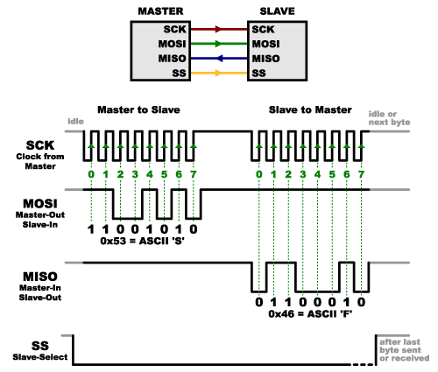
SPI Communication

Slide 3
SPI clocking: there is no “standard way”
Four clocking “modes”
Two phases
Two polarities
Master and selected slave must be in the same mode
During transfers with slaves A and B, Master must
Configure clock to Slave A’s clock mode
Select Slave A
Do transfer
Deselect Slave A
Configure clock to Slave B’s clock mode
Select Slave B
Do transfer
Deselect Slave B
Master reconfigures clock mode on-the-fly!

Slide 4
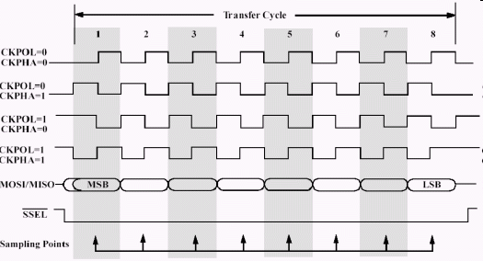
SPI timing diagram
Timing Diagram – Showing Clock polarities and phases

Slide 5
SPI Pros and Cons
Pros:
Fast and easy
Fast for point-to-point connections
Easily allows streaming/Constant data inflow
No addressing/Simple to implement
Everyone supports it
Cons:
SS makes multiple slaves very complicated
No acknowledgement ability
No inherent arbitration
No flow control

Slide 6
I2C bus
Communication with the accelerometer
Read acceleration values and configure interrupts
Pros
Two wires bus that can connect multiple peripherals with the MCU
Cons
Overhead is significantly higher, and bus is slower

Slide 7
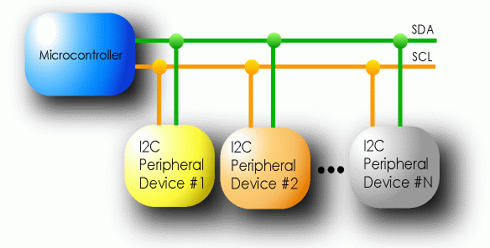
I2C Details
Two lines
Serial data line (SDA)
Serial clock line (SCL)
Only two wires for connecting multiple devices

Slide 8
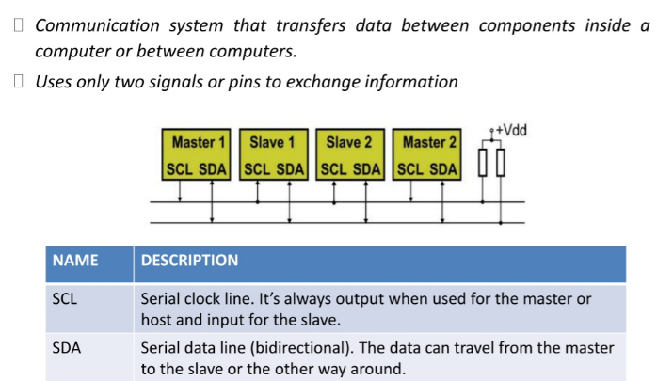
I2C Details

Slide 9
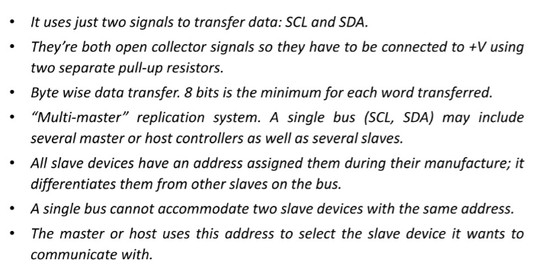
I2C Details

Slide 10
I2C Details
Each I2C device recognized by a unique address
Each I2C device can be either a transmitter or receiver
I2C devices can be masters or slaves for a data transfer
Master (usually a microcontroller): Initiates a data transfer on the bus, generates the clock signals to permit that transfer, and terminates the transfer
Slave: Any device addressed by the master at that time

Slide 11
How can any device transfer or receive on the same two wires?
Pull ups and high-impedance mode pins
Wires default to being “on”, any device can make a wire go “off”.
This is super clever. SPI and UART can’t do this, why?

Slide 12
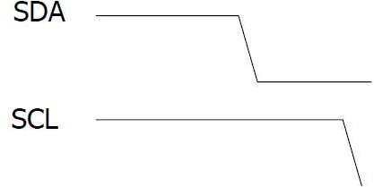























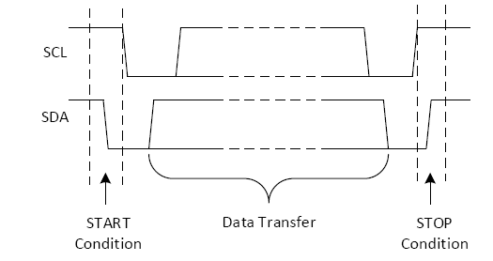
Start and Stop Condition

Slide 13
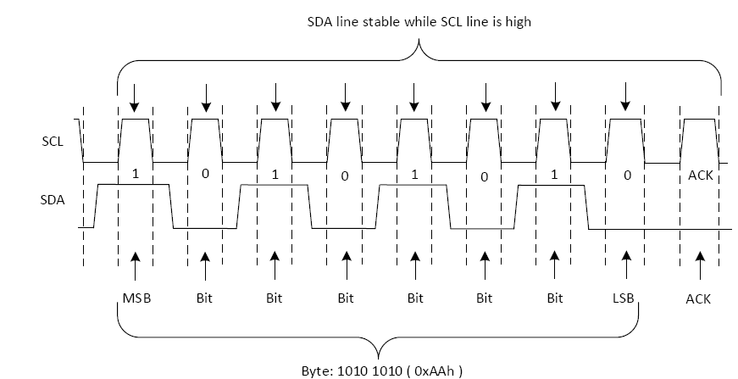
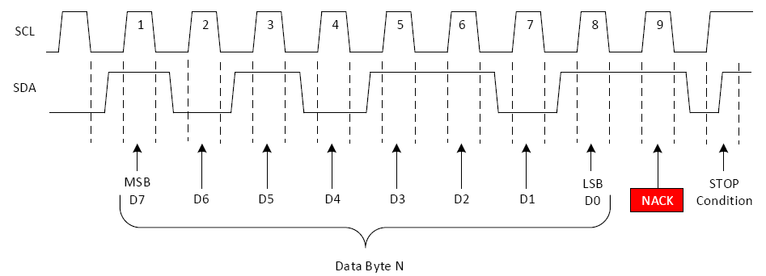
Acknowledge (ACK) and Not Acknowledge (NACK)
A transition of the data line while the clock line is high
is defined as either a start
or a stop condition.
Both start and stop conditions are generated by the bus master
The bus is considered busy after a start condition, until a stop condition occurs

Slide 14
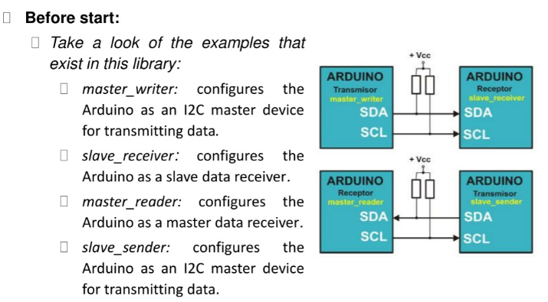
Bit Transfer on the I²C Bus

Slide 15
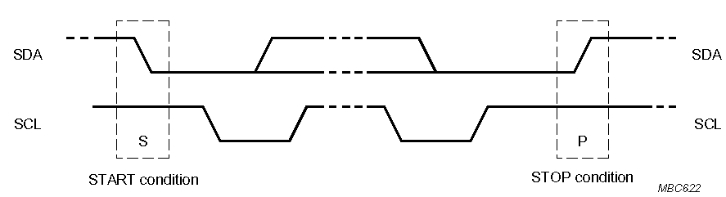
Start and Stop Conditions
A transition of the data line while the clock line is high is defined as either a start or a stop condition.
Both start and stop conditions are generated by the bus master
The bus is considered busy after a start condition, until a stop condition occurs
SDA
SDA
SCL
SCL
Start Condition
Stop Condition

Slide 16
I²C Addressing
Each node has a unique 7 (or 10) bit address
Peripherals often have fixed and programmable address portions
Addresses starting with 0000 or 1111 have special functions:-
0000000 Is a General Call Address
0000001 Is a Null (CBUS) Address

Slide 17
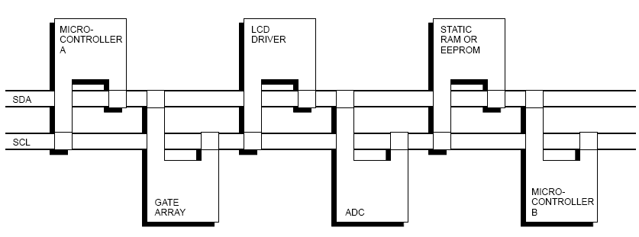
I2C-Connected System
Example I2C-connected system with two microcontrollers
(Source: I2C Specification, Philips)

Slide 18
Master-Slave Relationships
Who is the master?
master-transmitters
master-receivers
Suppose microcontroller A wants to send information to microcontroller B
A (master) addresses B (slave)
A (master-transmitter), sends data to B (slave-receiver)
A terminates the transfer.
If microcontroller A wants to receive information from microcontroller B
A (master) addresses microcontroller B (slave)
A (master-receiver) receives data from B (slave-transmitter)
A terminates the transfer
In both cases, the master (microcontroller A) generates the timing and terminates the transfer

Slide 19
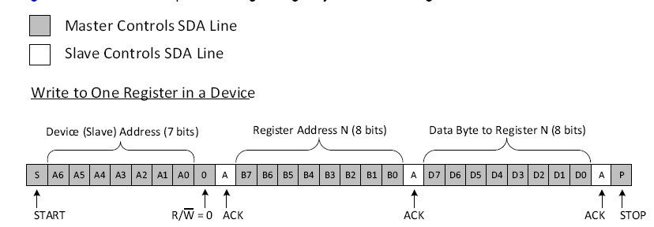
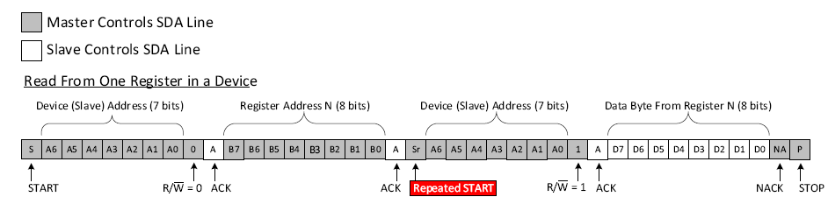
Read and Write Operation in I2C

Slide 20
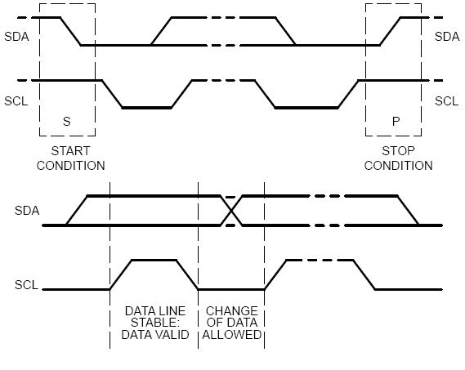

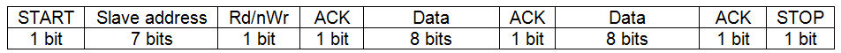

I²C protocol
Master initiates transfer with a START bit (SDA from high to low while SCL is high
Slave address (7 or 10 bits, 7 is most common)
Transfer type (1 bit: 0 to write, 1 to read)
All ICs compare address to their address
If address matches, device sends an ACKNOWLEDGE signal
If address does not match, device waits until bus is released by STOP condition
Once master receives ACKNOWLEDGE, it then sends (writes) or receives (reads) data
Receiver sends back ACKNOWLEDGE for each byte received
Master concludes the transfer with STOP bit
General structure of a 2-byte transfer
http://www.robot-electronics.co.uk/acatalog/I2C_Tutorial.html
Writing 2-bytes (shaded bits are put on the bus by the master)
Reading 2-bytes (shaded bits are put on the bus by the master)

